Slide 1
Electronics Systems (938II)
Lecture 1.1
Modern Electronic Systems (intro) – Design flow and HDL

Slide 2
Brief recall on CMOS technologies
Digital electronics systems
Different technologies

Slide 3
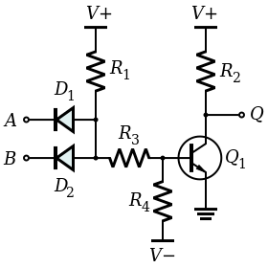
Brief recall on CMOS technologies
Digital electronics systems
Different technological families
DTL = Diode-Transistor Logic
NAND gate

Slide 4
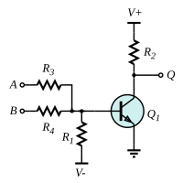
Brief recall on CMOS technologies
Digital electronics systems
Different technological families
DTL
RTL = Resistor-Transistor Logic
NOR gate

Slide 5
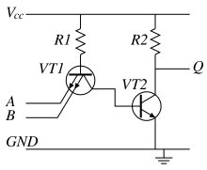
Brief recall on CMOS technologies
Digital electronics systems
Different technological families
DTL
RTL
TTL = Transistor-transistor Logic
NAND gate

Slide 6
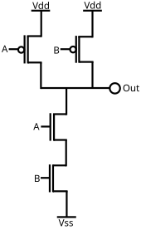
Brief recall on CMOS technologies*
Digital electronics systems
Different technological families
DTL
RTL
TTL
CMOS = Complementary MOS (logic)
p-MOS
n-MOS
NAND gate

Slide 7
Brief recall on CMOS technologies*
Digital electronics systems
Different technological families
DTL
RTL
TTL
CMOS
Dominant technology:
Very Large Scale Integration (VLSI)
Complete system on unique chip
Sensor
ADC
Digital logic

Slide 8
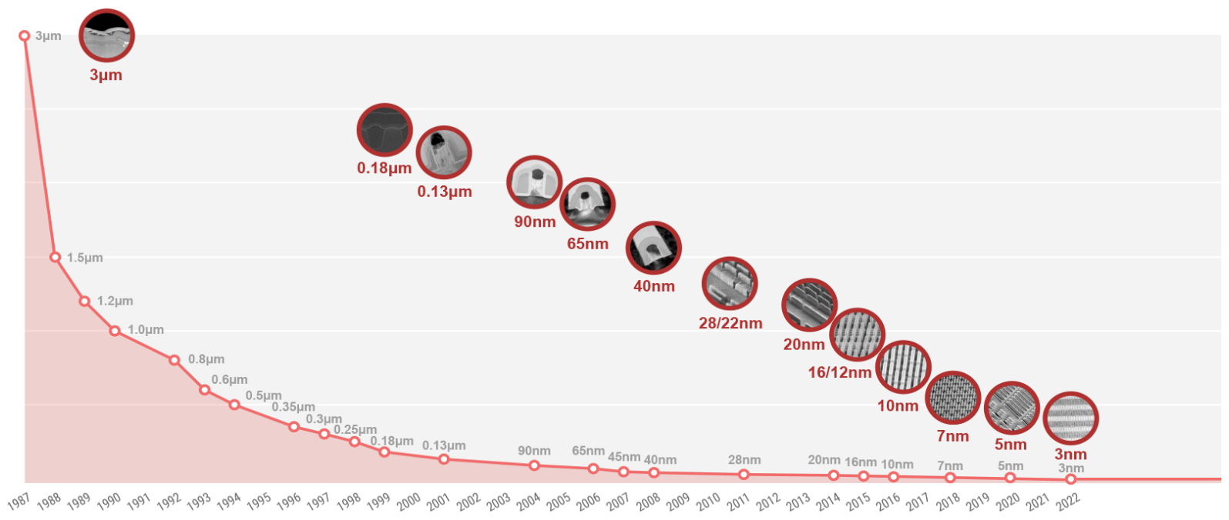
Integration Scale and VLSI circuits*
Extreme miniaturization supported by CMOS technologies
From TSMC* website:
* TSMC = semiconductor manufacturer

Slide 9
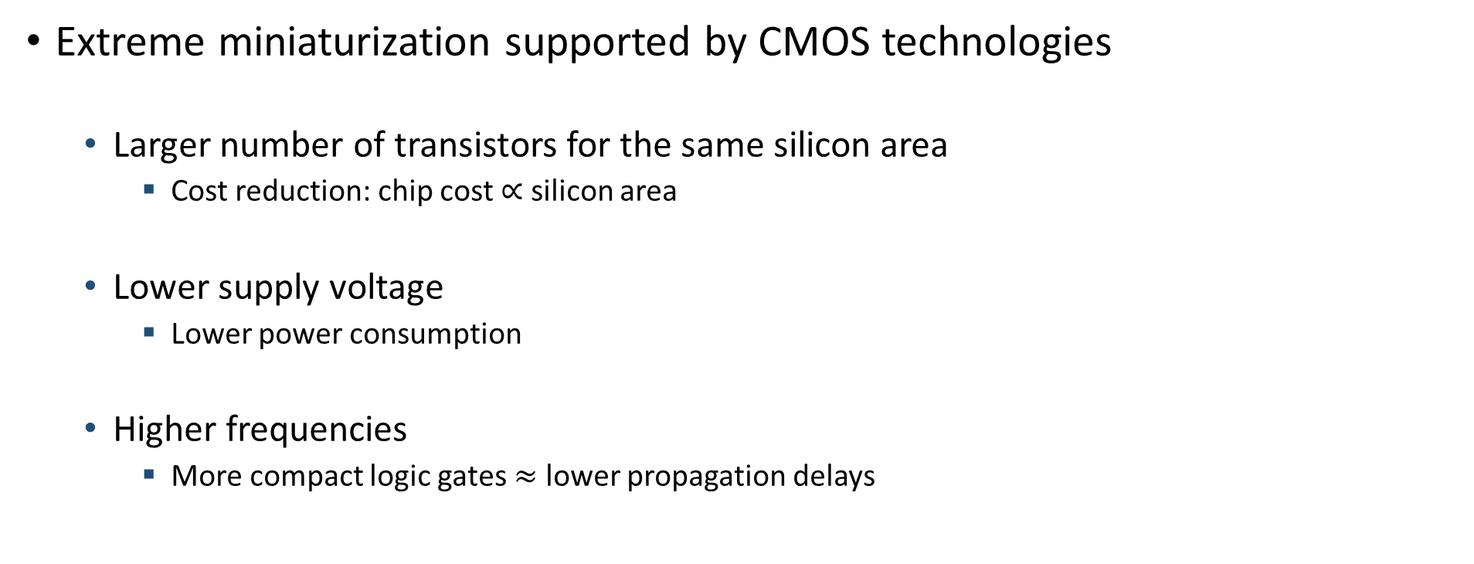
Integration Scale and VLSI circuits*
Extreme miniaturization supported by CMOS technologies
Larger number of transistors for the same silicon area
Cost reduction: chip cost $∝$ silicon area
Lower supply voltage
Lower power consumption
Higher frequencies
More compact logic gates $≈$ lower propagation delays

Slide 10





Integration Scale and VLSI circuits*
Number of transistors in the same chip
Over the years, we passed
From SSI (Small Scale Integration): transistor count $∝10$
To VLSI (Very Large Scale Integration): transistor count ${≥10}^{6}$
$$10$$
$${10}^{2}$$
$${10}^{3}÷{10}^{4}$$
$${≥10}^{6}$$
Order of magnitude of transistor count
SSI
(Small
Scale Integration)
MSI
(Medium
Scale Integration)
LSI
(Large
Scale Integration)
VLSI
(Very Large
Scale Integration)

Slide 11


Integration Scale and VLSI circuits*
Number of transistors in the same chip
Over the years, we passed
From SSI (Small Scale Integration): transistor count $∝10$
To VLSI (Very Large Scale Integration): transistor count ${≥10}^{6}$
$$10$$
$${10}^{2}$$
$${10}^{3}÷{10}^{4}$$
$${≥10}^{6}$$
Order of magnitude of transistor count
SSI
(Small
Scale Integration)
MSI
(Medium
Scale Integration)
LSI
(Large
Scale Integration)
VLSI
(Very Large
Scale Integration)

Slide 12
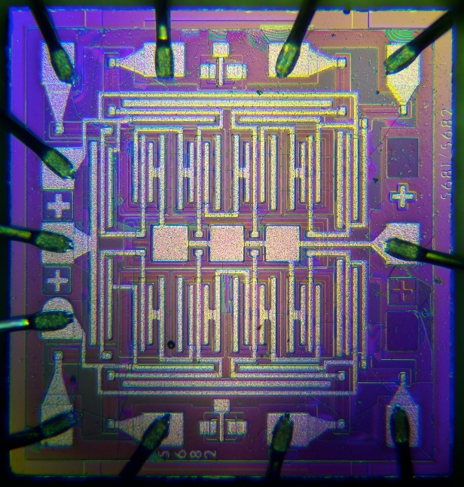
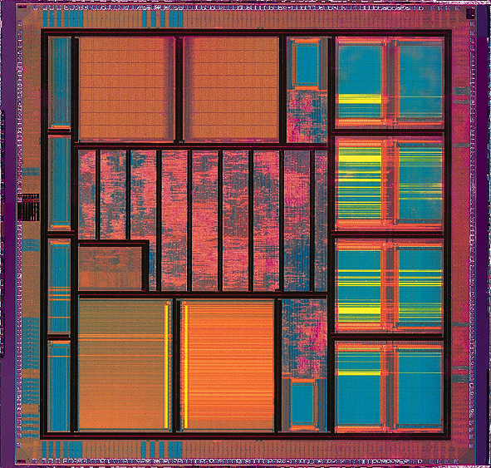
Integration Scale and VLSI circuits*
In other words, we passed …
… from this, …
… to this!

Slide 13
Integration Scale and VLSI circuits*
In other words, we passed …
… from this, …
… to this!
Layout of a modern Intel processor

Slide 14
Integration Scale and VLSI circuits*
In other words, we passed …
… from this, …
… to this!
Hand design
Automated design!!!

Slide 15
VLSI circuits*
Most modern digital electronic systems (or the digital part of an analog and digital system) are …
… VLSI circuits
… based on CMOS technologies
… designed using automated tools
EDA = Electronic Design Automation

Slide 16
VLSI circuits*
Most modern digital electronic systems (or the digital part of an analog and digital system) are …
… VLSI circuits
… based on CMOS technologies
… designed using automated tools
EDA = Electronic Design Automation

Slide 17

HDL for design of VLSI circuits*
Automated design of modern digital circuits relies on the usage of HDL languages
HDL = Hardware Description Language
Languages (programming code) that describe a (digital) circuit
HDL code
Corresponding circuit

Slide 18
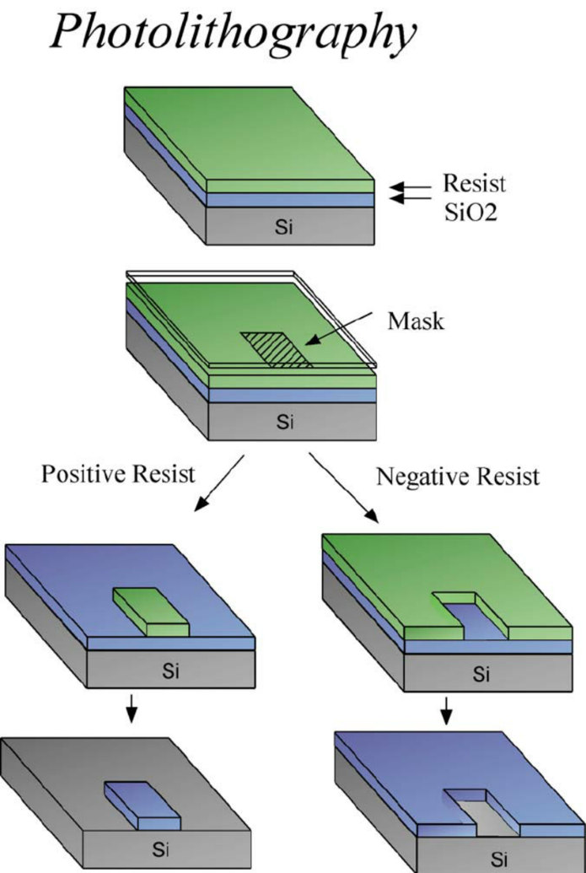
HDL for design of VLSI circuits*
Design flow
HDL code → Layout of the circuit
Circuits manufacturing
Photolithography
The circuit layout define the mask(s) used in the photolithographic process

Slide 19
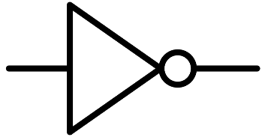
HDL for design of VLSI circuits*
Design flow
HDL code → Layout of the circuit
3 representation levels
RTL
Logic level
(or Gate level)
Transistor level
(layout)

Slide 20
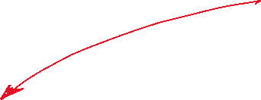

HDL for design of VLSI circuits*
Design flow
HDL code → Layout of the circuit
3 representation levels
RTL = Register Transfer Level
RTL
Logic level
(or Gate level)
Transistor level
(layout)

Slide 21
HDL for design of VLSI circuits*
RTL
Abstract description/representation of the circuit in terms of
Registers (we are going to see registers later)
Logical operation(s) on the signals from registers

Slide 22





HDL for design of VLSI circuits*
RTL
Abstract description/representation of the circuit in terms of
Registers (we are going to see registers later)
Logical operation(s) on the signals from registers

Slide 23
HDL for design of VLSI circuits*
RTL
Representation of circuit components/elements: corresponding functional symbol
Functional symbol of register
Functional symbol of generic function

Slide 24
HDL for design of VLSI circuits*
RTL
Representation of circuit components/elements: corresponding functional symbol
For functions/operations
The symbol may change depending on the operation it performs
For high-complexity functions, a generic box with an appropriate number of input(s) and output(s) is generally used
For single-gate functions (e.g., NOT, AND, NAND, OR, NOR, …), the functional symbol correspond to the gate-level symbol
Functional symbol of register
Functional symbol of generic function

Slide 25
HDL for design of VLSI circuits*
RTL
Representation of circuit components/elements: corresponding functional symbol
Examples of single-gate logical functions: NOT
(functional symbol – RTL)
(gate-level)

Slide 26
HDL for design of VLSI circuits*
RTL
Representation of circuit components/elements: corresponding functional symbol
Examples of single-gate logical functions: AND
(functional symbol – RTL)
(gate-level)

Slide 27
HDL for design of VLSI circuits*
RTL
Representation of circuit components/elements: corresponding functional symbol
Examples of single-gate logical functions: NOR
(functional symbol – RTL)
(gate-level)

Slide 28

HDL for design of VLSI circuits*
RTL
Examples

Slide 29




Brief recall on CMOS technologies*
Over the years, $V_{CC}$ scaled from $5 V$ down to $0.9 V$

Slide 30

Brief recall on CMOS technologies*
n-MOS transistor $≈$ controlled switch

Slide 31
Brief recall on CMOS technologies*
n-MOS transistor $≈$ controlled switch

Slide 32

Brief recall on CMOS technologies*
n-MOS transistor $≈$ controlled switch

Slide 33

Brief recall on CMOS technologies*
n-MOS transistor $≈$ controlled switch

Slide 34
Brief recall on CMOS technologies*
n-MOS transistor $≈$ controlled switch

Slide 35
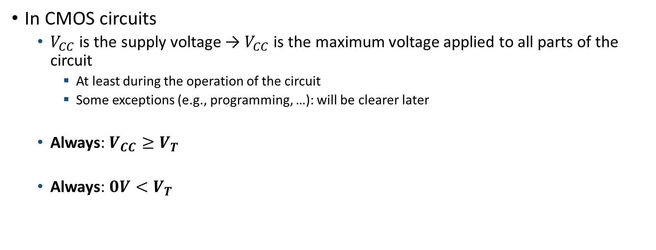
Brief recall on CMOS technologies*
In CMOS circuits
$V_{CC}$ is the supply voltage → $V_{CC}$ is the maximum voltage applied to all parts of the circuit
At least during the operation of the circuit
Some exceptions (e.g., programming, …): will be clearer later
Always: $V_{CC}≥V_{T}$
Always: $0V<V_{T}$

Slide 36
Brief recall on CMOS technologies*
n-MOS transistor $≈$ controlled switch

Slide 37

Brief recall on CMOS technologies*
p-MOS transistor $≈$ controlled switch (dual of n-MOS)

Slide 38
Brief recall on CMOS technologies*
Active-low signals
Definition
When 1, the (active-low) signal is disabled
When 0, the (active-low) signal is enabled

Slide 39
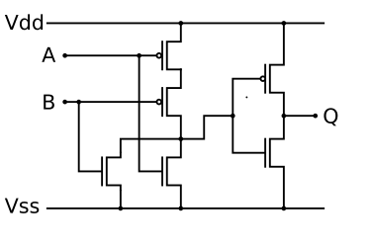








Brief recall on CMOS technologies*
Active-low signals
Why?
Active-low signals can
Reduce the gate count (so the costs)
Improve the circuit “speed” (reduce the delay)
NOR gate = NOR + NOT
NOR gate

